Slide 1

Capstone Project-EDA
Play Store App Review Analysis
Abstract:-
The Play Store apps data has enormous potential to drive app-making businesses to success. Actionable insights can be drawn for developers to work on and capture the Android market.
Each app (row) has values for category, rating, size, and more. Another dataset contains customer reviews of the android apps.
Explore and analyse the data to discover key factors responsible for app engagement and success.
Key Words:-
Google Play Store Apps, Ratings Prediction, Exploratory Data Analysis, Android market, customer reviews, App engagement and success.

Slide 2
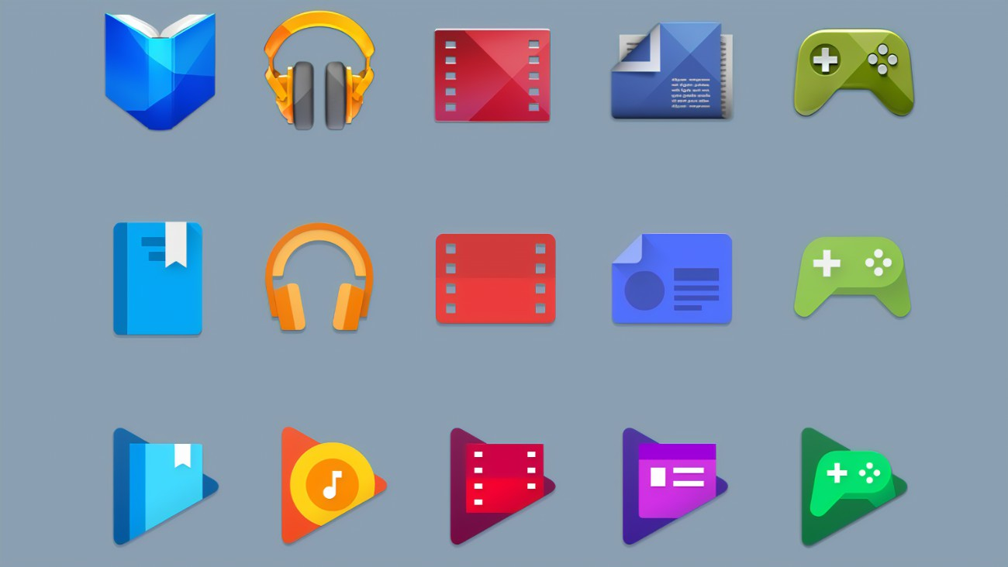
The data set-1 contains the following columns:-
App: This Column contains the name of the app
Category: This contains the category to which the app belongs. The category column contains 33 unique values.
Rating: This column contains the average value of the individual rating the app has received on the play store. Individual rating values can vary between 0 to 5.
Reviews: This column contains the number of people that have given their feedback for the app.
Size: This column contains the size of the app i.e. The memory space that the app occupies on the device after installation.
Installs: This column indicates the number of time that the app has been downloaded from the play store; these are approximate values and not absolute values.
Type: This column contains only two values- free and paid. They indicate whether the user must pay money to install the app on their device or not.
Price: For paid apps this column contains the price of the app, for free apps it contains the value 0

Slide 3
Content Rating: It indicates the targeted audience of the app and their age group.
Genre: This column contains to which genre the app belongs to, genre can be considered as a sub division of Category.
Last updated: This column contains the info about the date on which the last update for the app was launched.
Current version: Contains information about the current version of the app available on the play store.
Android version: Contains information about the version of the android OS on which the app can be installed
User reviews data frame has 64295 rows and 5 columns. The 5 columns are identified as follows:
App: Contains the name of the app with a short description (optional).
Translated Review: It contains the English translation of the review dropped by the user of the app.
Sentiment: It gives the attitude/emotion of the writer. It can be ‘Positive’, ‘Negative’, or ‘Neutral’.
Sentiment Polarity: It gives the polarity of the review. Its range is [-1,1], where 1 means ‘Positive statement’ and -1 means a ‘Negative statement’.
Sentiment Subjectivity: This value gives how close a reviewer’s opinion is to the opinion of the general public. Its range is [0,1]. Higher the subjectivity, closer is the reviewer’s opinion to the opinion of the general public, and lower subjectivity indicates the review is more of a factual information.

Slide 4
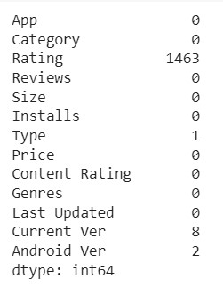
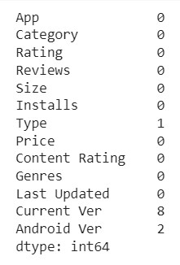
Data Cleaning and Preparation
Pre-processing is important into transitioning raw data into a more desirable format. Undergoing the pre-processing process can help with completeness and compellability. For instance, you'll see if certain values were recorded or not. Also, you'll see how trustable the info is. It could also help with finding how consistent the values are. We need pre-processing because most real-world data are dirty. Data can be noisy i.e. the data can contain outliers or simply errors generally. Data can also be incomplete i.e. there can be some missing values.
The available data is raw and unusable for exploratory data analysis, so before we do anything with the data we will have to explore and clean it to prepare it for data analysis.

Slide 5
Steps involved in this:
Step 1: We write a function play store info() that will display 5 attributes about all the columns. Data type,Count of null values,non null values,no. of unique values in that column and percentage of null value in that columns in play store dataset
Step 2: We start with the column Type we can see that it has one null value. We checked this row and Found out from play store that it is a free app. We use fillna () function of pandas library to fill this value
Step 3: We drop columns ‘Current Version’ ,’Android Versions , and last updated from our dataset using drop() function of pandas library
Step 4: We can see that ‘Rating’ column has 1474 null values. Due to low variations in rating values and a lot of repeated values the ‘median’ would be a suitable statistical indicator to replace null values with. We calculate the mode of the column using the median() aggregate method and fill this value in place of null values using fillna() function

Slide 6
Step 5: We can see that the ‘Reviews’ column despite being a numerical indicator is of the ‘object’ data type, we will convert this to ‘int’ data type using the as type(int) function.
Step 6: We can see that the size column, which should be numeric, is of the data type ‘object’, it also has characters ‘k’ and ‘M’ in the values which stand for kilobytes and Megabytes, we will replace the ‘k’ with 1000 and ‘M’ with 1000000. Some values also have ‘+’ sign in them, which will be removed. Next, we will convert this column into ‘int’ data type.
Step 7: The ‘Installs’ column values contain the characters ‘+’ and ‘,’ which are going to prevent us from converting this column into a numeric data type. We will get rid of these using the strip () and replace () function
Step 8: The values in the column ‘Price’ might have the ‘$’ sign in some values and the column is of the data type ‘object’. We will first remove the ‘$’ sign using the strip () function and then convert the column into ‘int’ data type.
Step 9: Handling the duplicates in the App column we drop the no of duplicate rows that are present in the App columns
Step 10: We write a function Ur info(), that will display 5 attributes about all the columns: Data type, Count of non-null values, Count of null values ,number of unique values in that column and percentage of null value in that columns in the User review
Step11: In the User review dataset the columns are App, Translated Review, Sentiment, Sentiment Polarity, Sentiment Subjectivity in this total 26863 NaN value are present so we drop them using dropna () function.

Slide 7
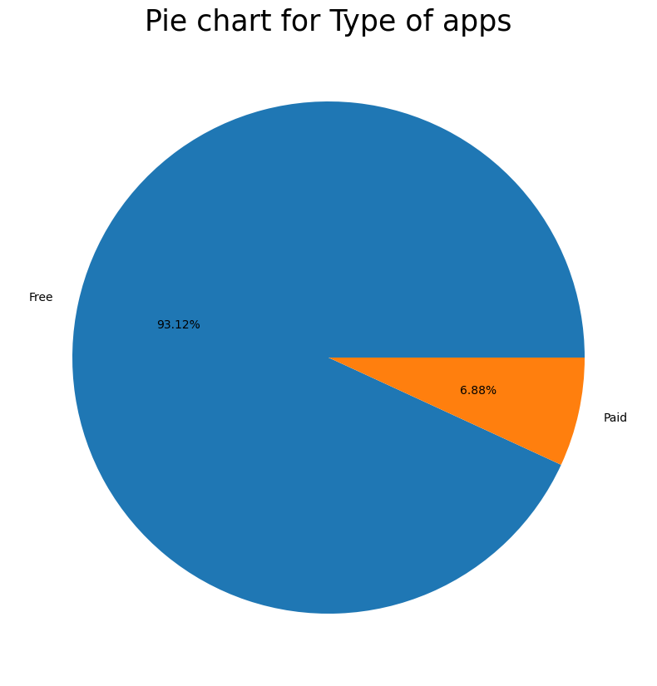
Free vs. Paid
Here we can see that 93.12% apps are free, and 6.88% apps are paid on Google Play Store,so we can say that Most ofthe apps are free on Google Play Store

Slide 8
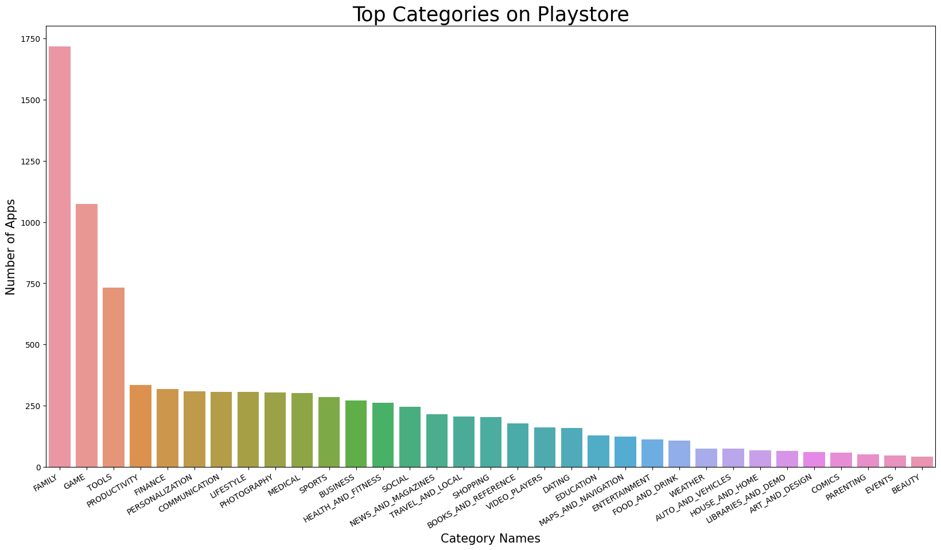
Top Category of Play store
So, there are all total 33 categories in the dataset From the above output we can come to a conclusion that in play store most of the apps are under FAMILY & GAME category and least are of EVENTS & BEAUTY Category.

Slide 9
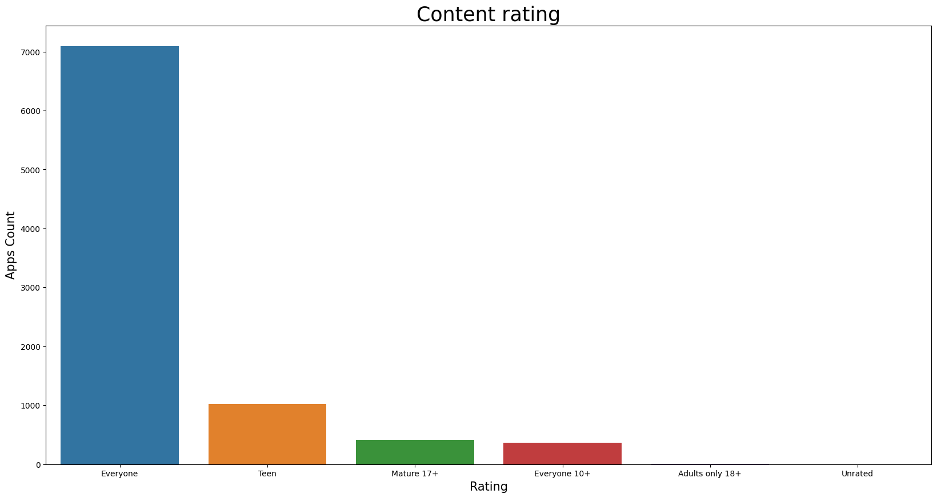
Mostly 90% of total apps are targetting audience in every age group and hence open for everyone. Very few(less then 500 apps) are catering to only adult population i.e Mature 17+

Slide 10
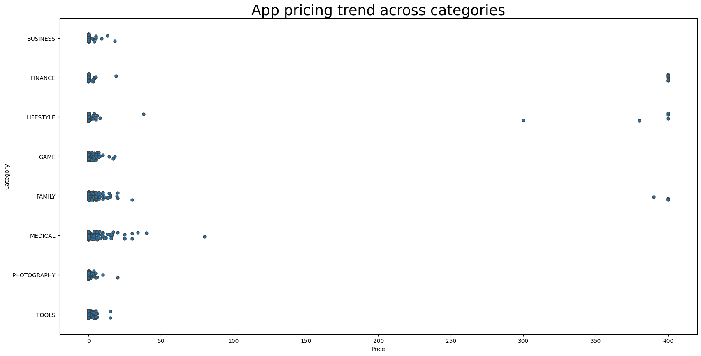
App price trend across categories
Strip plot use to visualise the distribution of many individual one-dimensional values. It is a good complement to a boxplot or violinplot in cases where all observations are shown along with some representation of the underlying distribution
Here we can see that Different categories apps demand different price ranges. Some apps that are simple and easy are free, where as apps in category FAMILY LIFESTYLE FINANCE and MEDICAL are high in price.

Slide 11
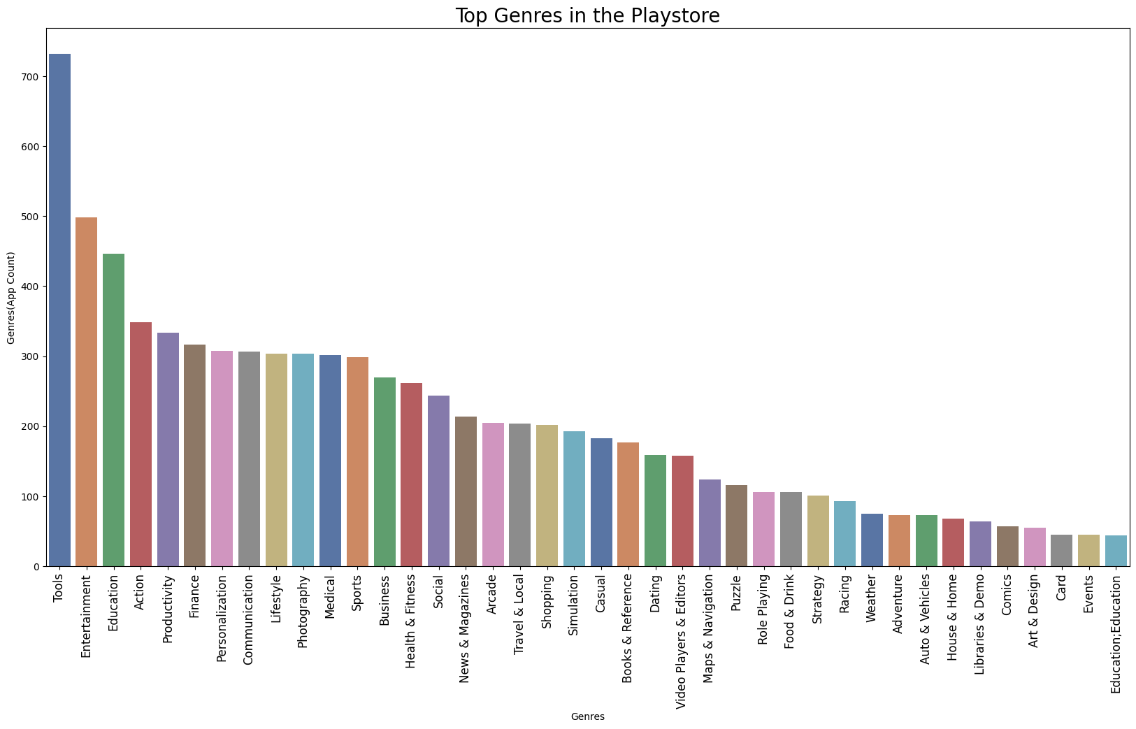
Top genres in playstore
From the above visualization we can see that the Highest Number of Apps found in the Tools and Entertainment genres followed by Education, Productivity, Finance and many more.

Slide 12
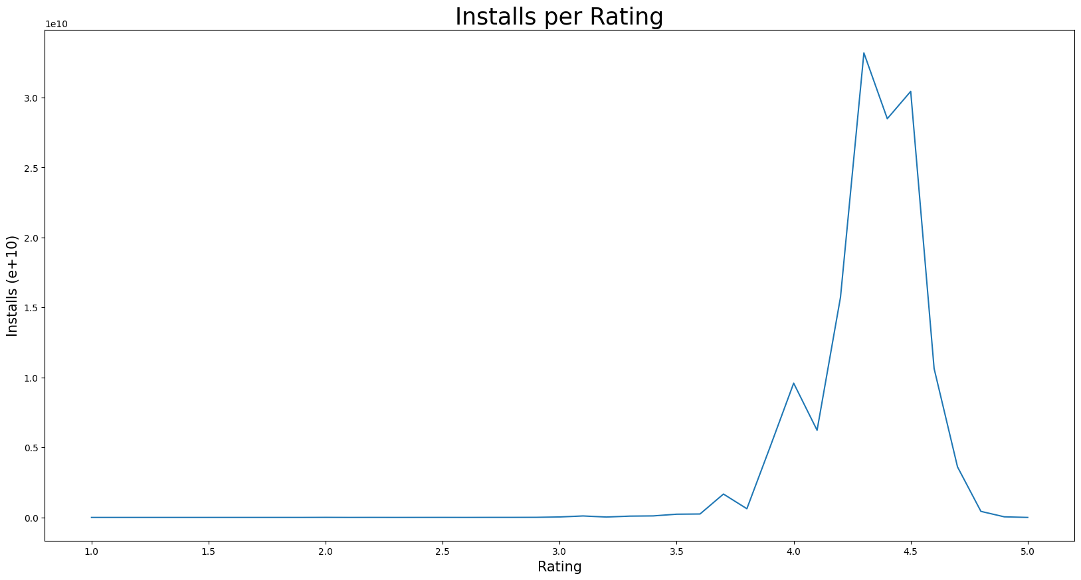
Installs per Rating
App ratings on the Google Play Store are predominantly in the higher range, with most ratings falling between 3-5. The majority of ratings are densely concentrated in the 4.2-4.7 range, indicating that users tend to give positive ratings to apps.
We also found that A low rating on the Google Play Store can hurt app downloads as potential users may choose alternative apps with better ratings. Maintaining a positive rating is crucial for app success.

Slide 13
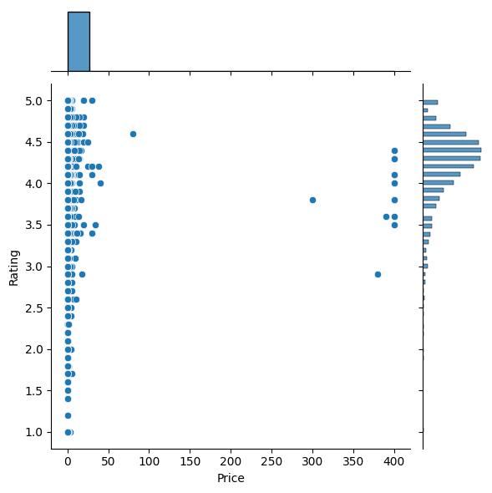
Relation between Rating and Price
Jointplot be used to quickly visualize and analyze the relationship between two variables and describe their individual distributions on the same plot
Apps which are low in price are more in numbers, also rating is also good for these apps.

Slide 14
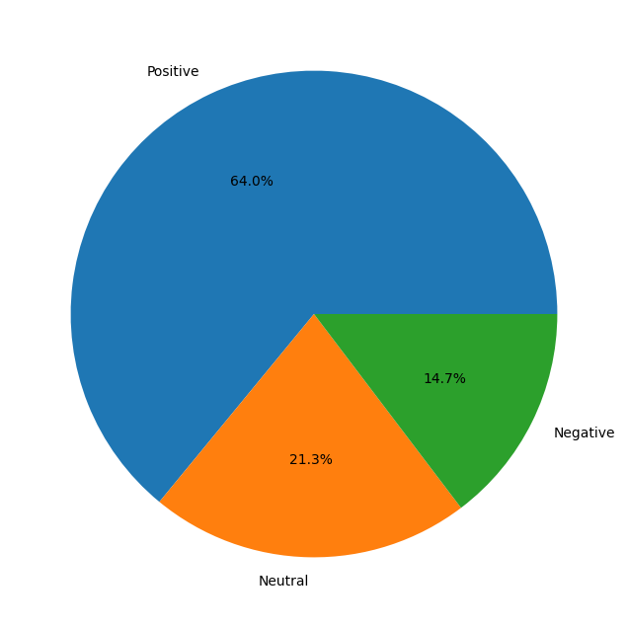
Pie Plot- Comparison between sentiment factors
The chart shows that the majority of sentiments are Positive, while the Negative and Neutral sentiments account for a smaller proportion.

Slide 15
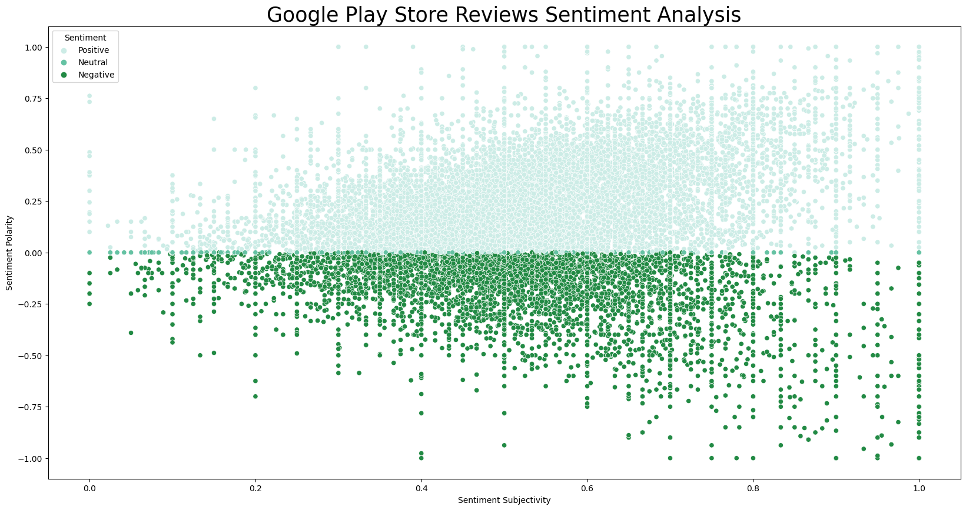
Sentiment Analysis
Scatter plots are useful when you want to understand the relationship between two numerical variables.
The concentration of points in the range of 0.5 to 0.8 for sentiment subjectivity suggests that most of the reviews are expressing opinions and experiences

Slide 16
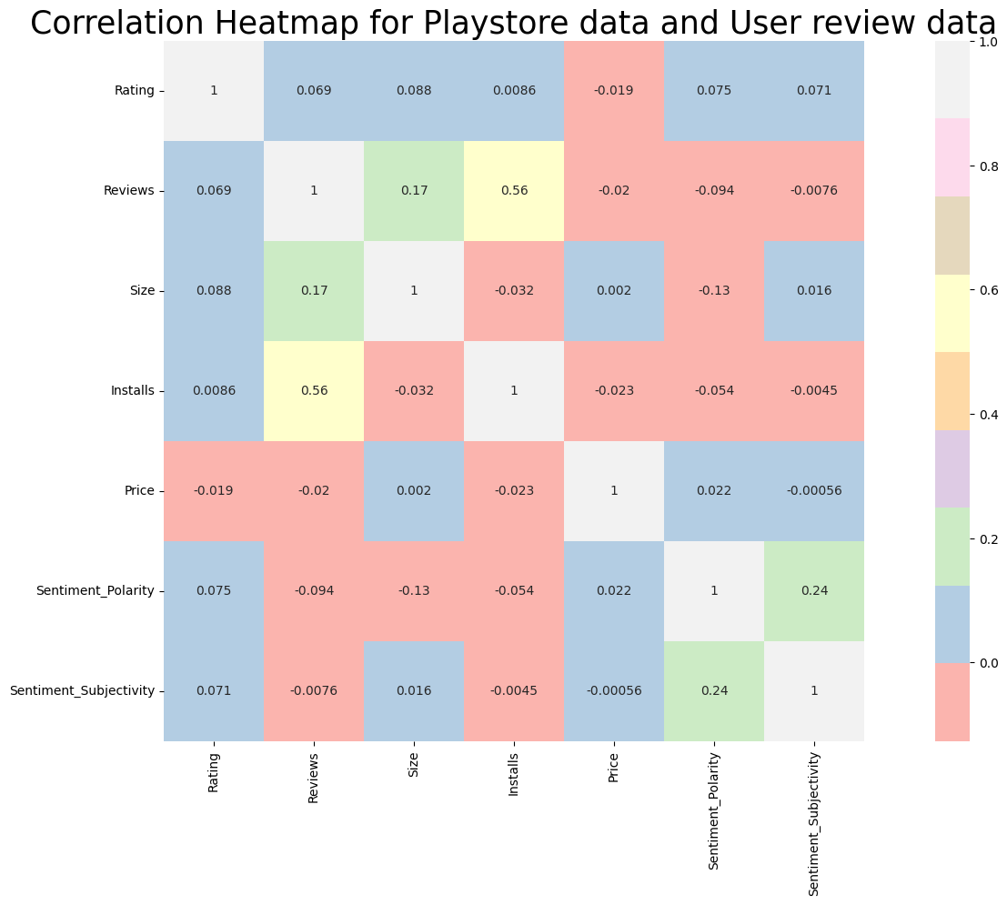
Correlation Heatmap
Size and sentiment polarity are negatively correlated(-0.19). There may be a reason when the size of an app increases people start disliking the app because it consumes more storage, takes more RAM and needs a high speed connection for its execution.
There is a positive correlation between reviews and number of installs(0.56) because as the reviews increase, people start noticing the app and install them.

Slide 17
Conclusion:
The app rating is significant and positively correlated with the number of installs. Additionally, a negative correlation exists between app price and rating.
Larger-sized paid apps may not perform well in the market. Users tend to prefer lightweight paid apps.
"Art and Design," "Family," and "Lifestyle" categories are leading in terms of potential for installs and revenue.
The majority of apps are free, while others are paid.
The "Game" category has the highest number of installs and is a potential market for developers.
Offering a free app with a content rating suitable for everyone is a viable strategy.
Regular updates and an optimal app size are key factors for achieving a high rating.
The "Family," "Game," and "Tools" categories have the maximum number of apps.
The focus of the conclusion does not directly address this question.
Offering a free app with a content rating suitable for everyone is a viable strategy.
A positive correlation exists between app ratings and the number of installs.
The conclusion highlights a negative correlation between app price and rating, and a positive correlation between installs and rating.
Positive sentiments dominate, with 61% of users expressing positive feelings.
Paid apps tend to receive more critical reviews compared to free apps, indicating a difference in sentiment polarity.

